Slide 1
Python for Data Science

Slide 2
What is Data Science?
Data-driven science – interdisciplinary field of scientific methods, processes and systems
Used to extract knowledge or insights from data in various forms – structured or unstructured
Way to discover hidden patterns in raw data

Slide 3
Why Python over R for Data Science?
Variety of data-science and data-analytics libraries available
  Pandas
  NumPy and SciPy
  Scikit-learn and TensorFlow
  Matplotlib and Seaborn
Also 70k+ python packages (PyPI) to support the code development

Slide 4
Essential Python Libraries for Data Scientists
Pandas
  Can perform both basic cleanup and advance data manipulation
NumPy
  Facilitates easy and efficient numeric computations
Scipy
  Tools needed for scientific and technical computation
Matplotlib
  Represent the data visually – graphs, charts etc

Slide 5
Machine Learning Frameworks in Python
Scikit-learn
  Simplest of the frameworks for classic machine-learning and data analytics
TensorFlow
  Most popular framework. Specializes with Deep Learning algorithms
  High processing capabilities and more useful in solving real-world problems
Keras
  API designed for implementing Deep Learning algorithms
  Based on TensorFlow 2.0

Slide 6
Data Science Methodologies
Machine Learning for Predictions
  Classical way – use existing observations (data) to train the model
  Based on the training, the model predicts for new/unseen data
Machine Learnig for Pattern Discovery
  Clustering – identify patterns within the data and define clusters
Predictive Analytics
  Prescribe actions and the outcomes associated with those
  Take a descision and improvise based on feedback

Slide 7
Data Science Applications
Image Recognition
Speech Recognition
Internet Search
Digital Advertising
Recommender Systems
Gaming
Delivery Logistics
Fraud and Risk Detection

Slide 8
Business Intelligence vs Data Science
BI applies to structured data alone. DS can handle both structured and unstructured
BI focuses on past, present and reporting. DS focuses on present and future predictions
Approach for BI is statistics and visualisation. For DS its data analysis/mining, machine learning and predictions

Slide 9
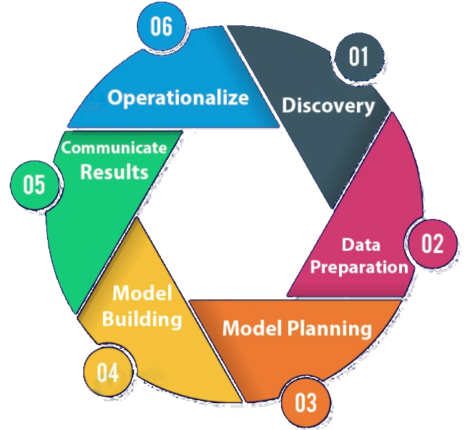
Data Science Lifecycle

Slide 10
Data Science Lifecycle
Discovery
  Understand the requirement, form initial hypothesis
Data Preparation
  Extract, transform and load the data as needed
Model Planning
  Choose the best/optimum model by carrying out exploratory data analytics - statistical and visual

Slide 11
Data Science Lifecycle
Model Building
  Define the training/testing sets and build the model
Communicate Results
  Document the findings, communicate to stakeholders and acknowledge if the goals have been met
Operationalize
  Formally implement and automate the solution for live environment

Slide 12
Python for Data Science

